Slide 1
Electric Vehicles – A Regional Perspective
Marisa O’Halloran – GBGA Project Manager

Slide 2
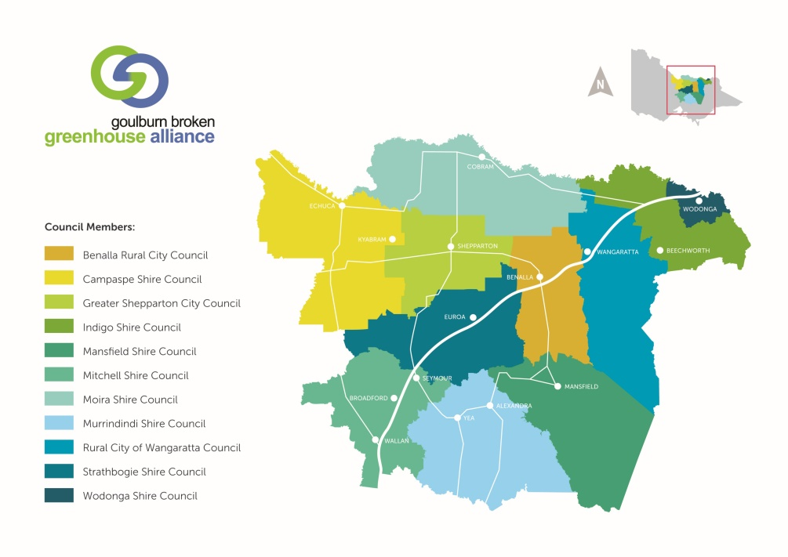
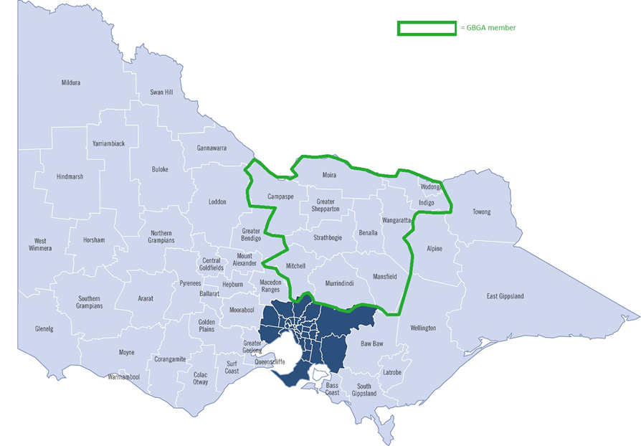
Our Region – Goulburn Broken and North East Victoria
11 Councils and two Catchment Management Authorities
Major Industries:
Tourism
Agriculture
Transport
Agencies and health services
Vehicle Dependent

Slide 3
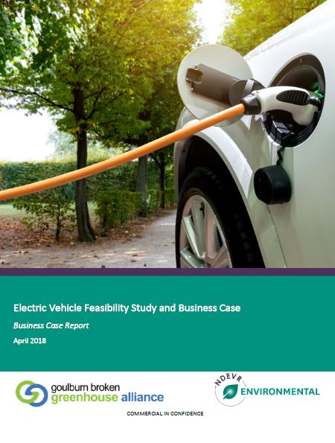
The ‘Building the Case for Electric Vehicles in Regional Council Fleets’ project
EV tourism opportunity
Climate change and Greenhouse Gas emissions; Council fleet impacts and leadership
LGV – Collaborating Council Sustainability Fund Partnership Program
12 month project with eleven partner councils
Feasibility Study and Business Case
Fleet Comparison Tool
EV forums – LG/fleet and community

Slide 4
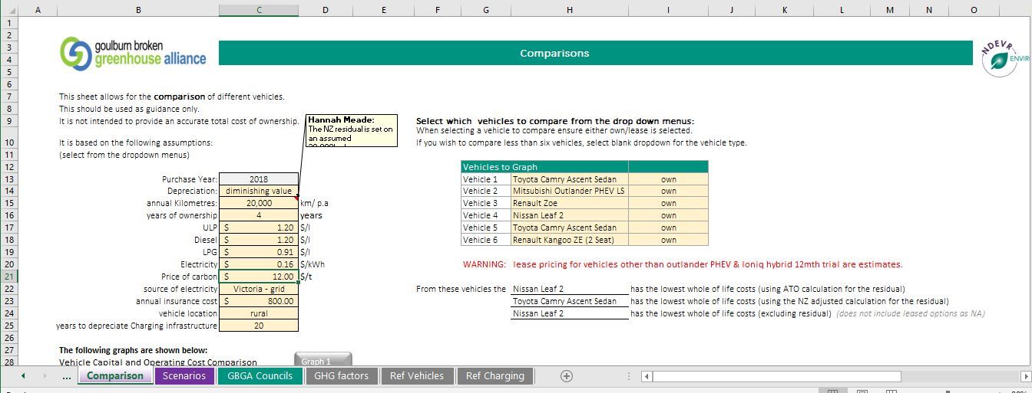
Our Regional Council Fleets
Mix of vehicles (Passenger; Utility; Heavy)
Mix of travel distances (Local; Municipality-wide; Between municipalities/metro Melbourne)
Fleet costs to Councils (Fuel; Vehicle purchase costs/resale value; vehicle maintenance and management; emissions tracking)
Are there suitable, fit-for-purpose electric vehicles that will reduce costs and emissions?

Slide 5
Challenges for EVs in our regional fleets
Limited fit-for-purpose vehicles (passenger, 4WD, towing capacity, heavy vehicles)
Range Anxiety – large distances to travel in regional areas
Universal charging infrastructure for fleets – will current charge points be compatible with future vehicles if we invest now?
Limited understanding of EVs by staff – change management
Local supply and servicing
Rapidly changing space – vehicle availability, vehicle costs, technology improvements, government incentives

Slide 6
Project Learnings
Cost-effective, fit-for-purpose EVs are available for Councils to purchase
EVs reduce GHG emissions even when grid-powered (solar is opportunity in regions)
Price premium and residual price uncertainty impact on total cost of ownership
Prepare for the future: planning conditions for new developments; supportive internal policies; set fleet targets; improve data collection
Continue to work together: EOI for bulk buy options (vehicles and charging infrastructure); employee and community engagement
Transition to EVs – broader fleet improvement strategies

Slide 7
EV Tourism in the Region
Limited public EV charging infrastructure in region
Telsa superchargers in Euroa and Wodonga
Tesla destination charges at select locations
Limited ability to attract all EV owners to the region
Interest from local community in EVs
Interest in developing EV touring route with universal change points linking entire region for all EV makes

Slide 8
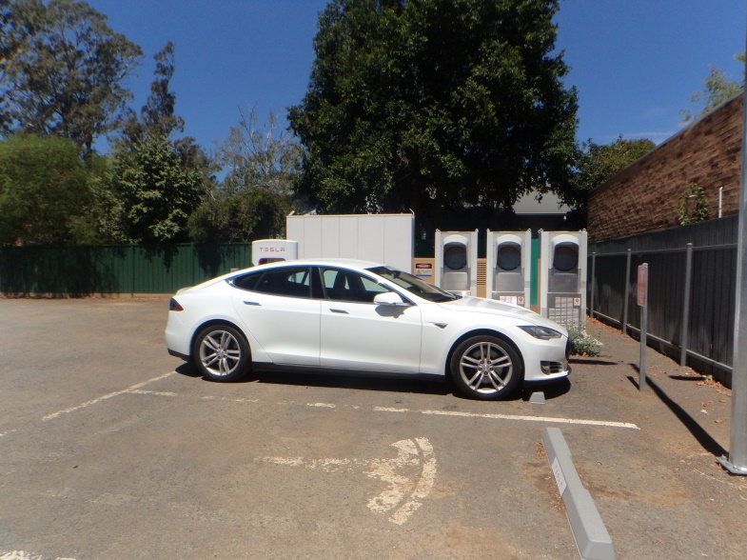
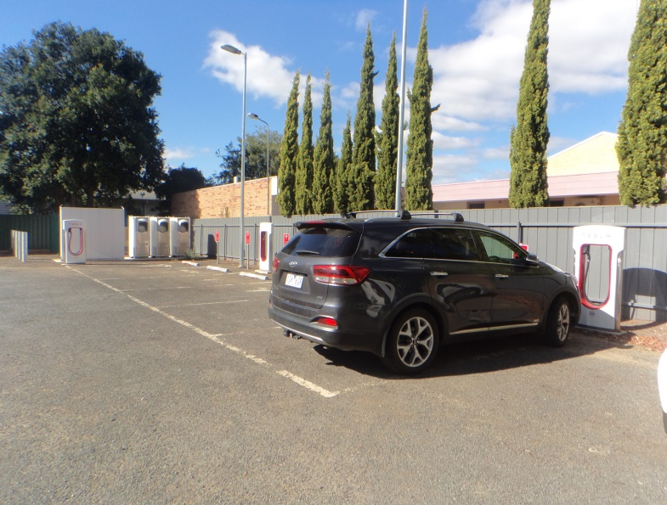
Case Study: Euroa Tesla Superchargers
Tesla superchargers installed in Strathbogie Shire Council carpark in Euroa (servicing Melbourne to Sydney route)
Central location – close to amenities, park and main street
Positive economic impact for the town
Learning opportunities

Slide 9
Goulburn Broken Greenhouse Alliance – www.gbga.com.au
Our communities actively responding to climate change to help build a positive future

