Slide 1
Victorian Government Investment in Organics Recovery

Slide 2
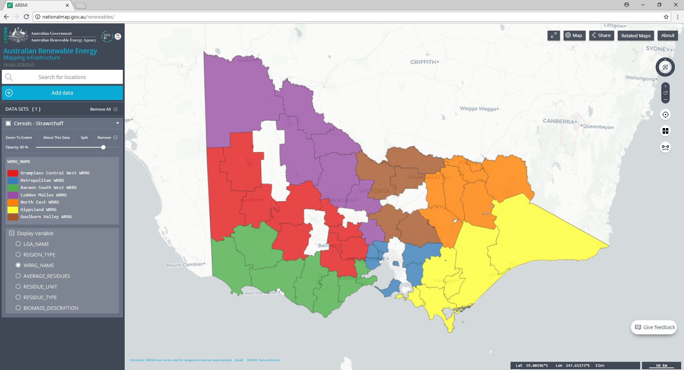
Victorian Organics Resource
Recovery Strategy (2015)
Environmental, human & animal health and amenity management
Sustainable markets
Leverage existing assets
Identify future needs
Building collective knowledge
Notes:
The other strategic directions include:
Education to facilitate change
Streamlined governance and strong leadership
Under - Environmental, human & animal health and amenity management: Organic waste management framework - Waste to Land project currently led by the EPA which will in the longer term ensure regulatory certainty around application of recovered organic residues to land. This incorporates sample testing of substrates such as composts and digestate amongst others to establish nutrient properties and potential contaminants to be managed through re-processing methods. Biosecurity Risk Assessment
Under - Sustainable markets: Demonstration projects, education programs, industry guides and SV’s social and market research project focusses on agriculture as a key market opportunity for the RO industry, understanding the propensity of farm sectors to adopt the application of compost as an supplementary to alternative approach to soil management is the key driver to this project.
Demonstration projects, education programs, industry guides to support implementation of a quality management approach for the compost sector that improves market confidence in RO products: Demo at Stanhope with an existing re-processor; Social Research on farmers perceptions of RO compost – lack of knowledge of their benefits and existing practices lead to a lack of a want change. Thus the demonstration project and creating guides,
Leverage existing assets – the Australian Biomass for Bioenergy Assessment project.
Identify future needs - Industry guides = RR tech guide and guide to biological recovery of organics;
Building collective knowledge point - Guide to Biological Recovery of Organics
Guide to organic waste collection
Mechanisms for ‘buy-back’ options in contracts

Slide 3
W2E Infrastructure Fund (2017)
$2 million for recovery of organic waste
Funding four anaerobic digesters
40,000 tpa diversion solid (food) and liquid (waste-water) waste
Expected abatement of over 55,000 tpa
Notes:
• Western Region Water Corporation will receive $802,784 to collect organic waste material and generate energy
• East Gippsland Region Water Corporation will receive $209,765 to enhance an existing bio-digester to process septic tank waste, food waste, fats, oils and greases
• Nestle Australia will receive $182,510 to create a system where organic waste from starch based soft confectionery is used for bioenergy
• Resource Resolution will receive $900,000 to help it build an anaerobic digester to divert local commercial food waste and other organics from landfill.
To be commissioned end of 2019.
2.5 MW total

Slide 4
Optimising Kerbside Collection Systems (2017)
Recycle the same core set of material
Consistent bin configurations
Consistent bin colours
Notes:
A Framework for Greater Consistency in Kerbside Recycling in Victoria
‘Optimising Kerbside Collection Systems’ offers the opportunity to increase recycling, improve the quality of recycled materials and reduce contamination through a more consistent approach to how we recycle. It is based on three approaches; households to recycle the same core set of materials, consistent bin configurations, and consistent bin colours.
To support the framework, a guide to preferred service standards for kerbside recycling in Victoria, and recycling guidelines have also been developed. These provide a clear and consistent direction for local government in relation to kerbside recycling service standards and performance outcomes, and are supported by key stakeholders from across the sector.’

Slide 5
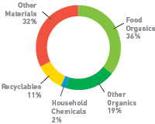
Kerbside FOGO
Kerbside collection services for food and garden organics to 16,500 HH’s in the 1st year
Annually diverting 12,000 tonnes from landfill
Diverting over 30% of residual waste from landfill
Average annual reduction of 100 kg/ household of waste to landfill
Using equivalent abatement values equates to just under 20,000 tpa CO2-e avoided
Notes:
The Goulburn Valley WRRG’s pledge to deliver infrastructure to at least 25,000 households in the Goulburn Valley and divert over 7300 tonnes has been achieved. Over 30,000 tenements now have access to a FOGO kerbside service supplied with a kitchen caddy, and approximately 12,000 tonnes have been processed annually. The figures also indicate over 3,500 tonnes were directly diverted from landfill in the last financial year.
Moira is consistently under .5% contamination. This achievement speaks volumes of their management in the kerbside contract. Implementing a FOGO service was frowned upon across industry professional, with concerns the acceptance of food would lead to higher contamination.
• The councils strong relationship with their contractor has proven be a strong driver in maintain low contamination and high presentation rates.
• Their pioneering work in FOGO earned them a Premier’s Sustainability Award and a finalist in the Banksia Award.
• Council’s use of B2E with ongoing competitions and media releases help reinforce their message.
• Strathbogie is currently diverting 47% from landfill post FOGO. This figure is leading the region and would be also a front runner in the state.
• Of the three kerbside streams collected, waste to landfill now contributes the lowest in terms of tonnages (some 270 tonnes less than organics and 45 tonnes less than recycling).
Shepparton Council’s introduction to FOGO has also provided them the opportunity to increase their kerbside service to well over 20,000 tenements.
• The council’s FOGO service makes up the lion’s share of the annual tonnages with over 7,500 tonnes being processed.
The myths around contamination will increase with food acceptance, weekly FOGO kerbside collections not working and claims that corn starch bags don’t breakdown in the composting process have all been dispelled through the project. The operational and contractual learnings from the participating councils have been of the greatest value in advising and guiding other councils around the opportunities and traps when introducing a FOGO service.
Campaspe will also be introducing FOGO in 2020

Slide 6
Building Victoria’s Organics Recovery (2012)
Kerbside collection services for food and garden organics to 74,570 HH’s
Organic processing capacity increased by 38,250 tpa
Average 19,905 tpa diverted from landfill
Abatement of 32,621 t CO₂-e/year*
Notes:
A $2.5 million program commenced in 2012 which resulted in the following high level benefits:
74,570 Victorian households now have ongoing kerbside collection services for food and/or garden organics
Annual organic processing capacity in regional Victoria has increased by 38,250 tonnes per year
An average of 19,905 tonnes of organics is currently being diverted from landfill per year by new organics kerbside collection services and this will increase with effective community education to improve uptake rates of optional kerbside organics collection services
New kerbside organics collection services have resulted in an average abatement of 32,621 tonnes of CO₂e per year. In FY18/19 this will increase to 81,621 tonnes of CO₂e per year as Geelong becomes operational (construction completion June 2018).

Slide 7
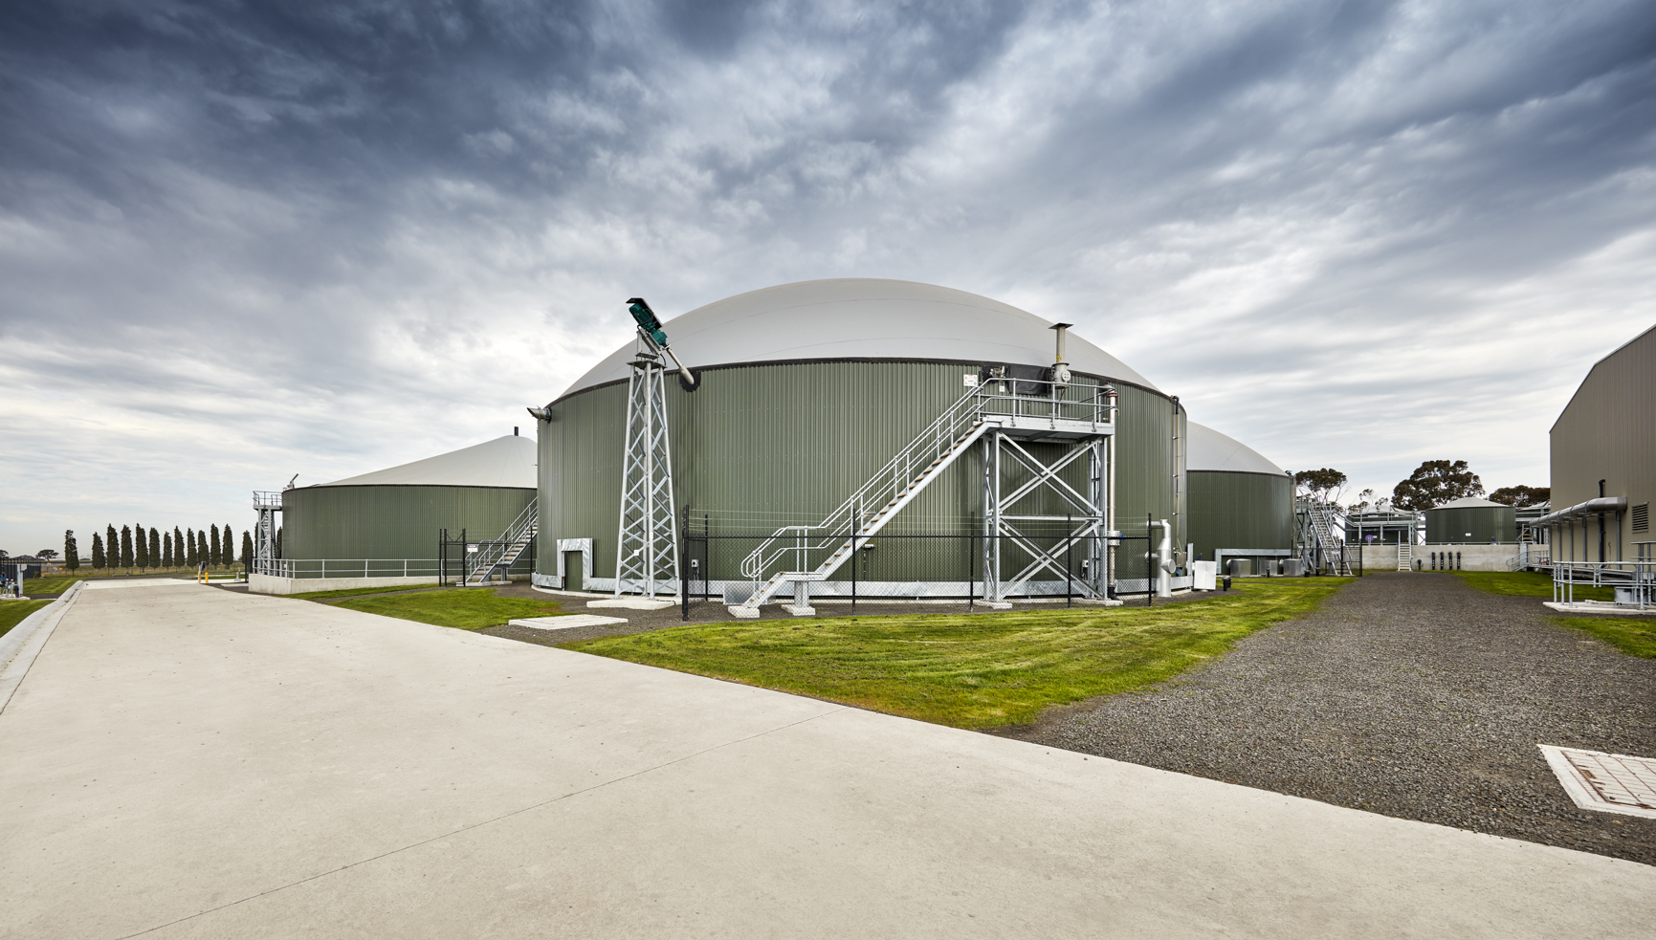
Notes:
Do we have an all encompassing record of the diversion of organics from landfill from all these initiatives? E.g. since 2012 and the inception of the BVOR to today and the continued funding of FOGO collections we’ve seen the diversion of ____,____ tonnes of organic residues from landfill.
One of the daily facts we need to consider is that 60% of the emissions produced in our economy are locked up in the material flows of the products, supply chains that we rely upon everyday for our material comfort.

