Slide 1
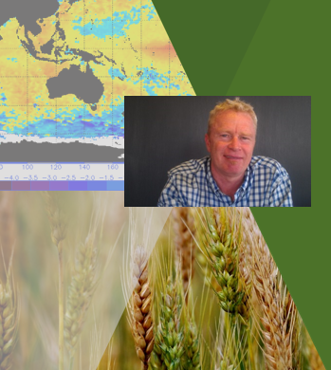
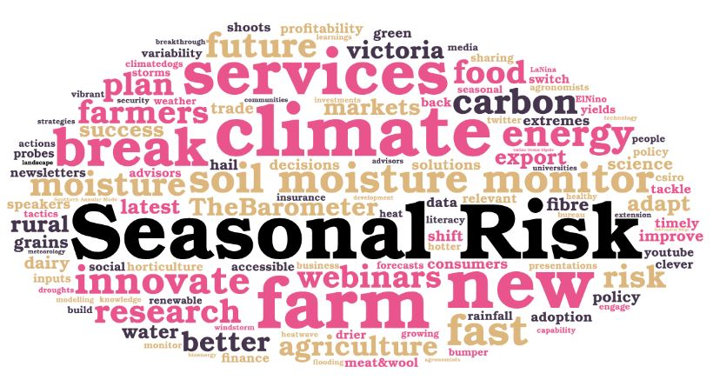
Engaging, adapting, adopting………….
Graeme Anderson
Climate Specialist
Agriculture Victoria
20th July 2018

Slide 2
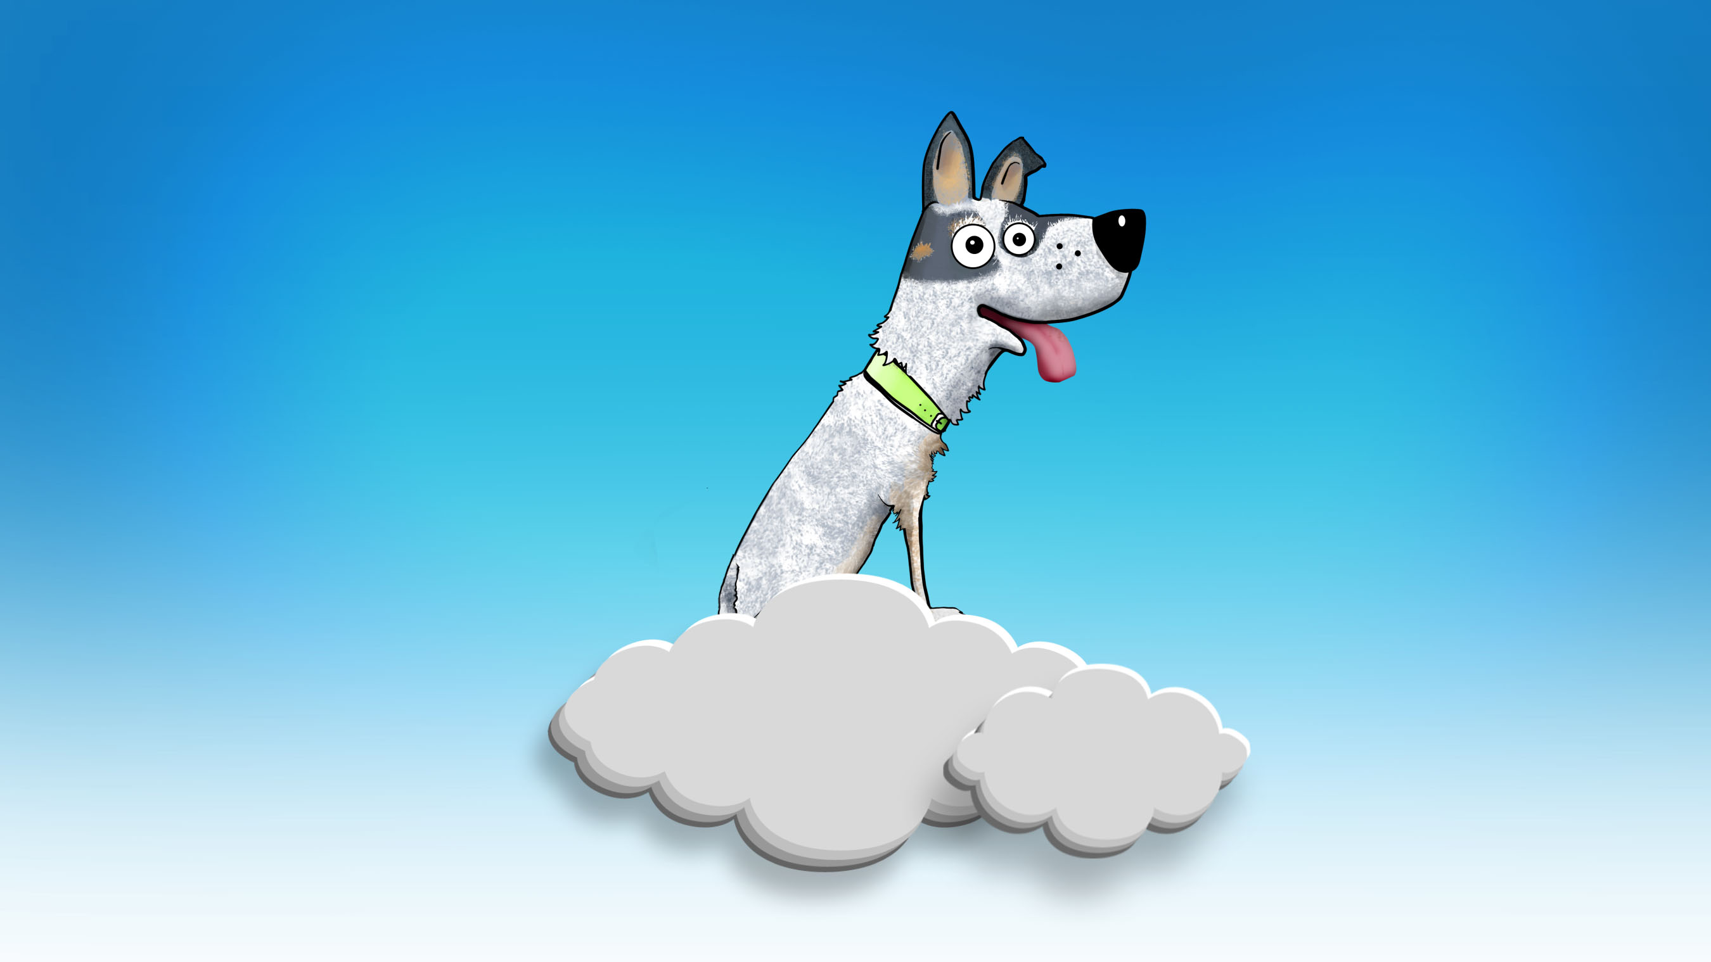
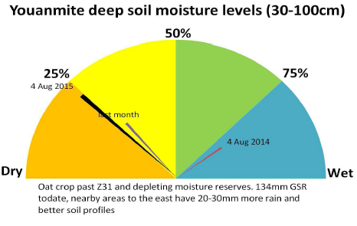
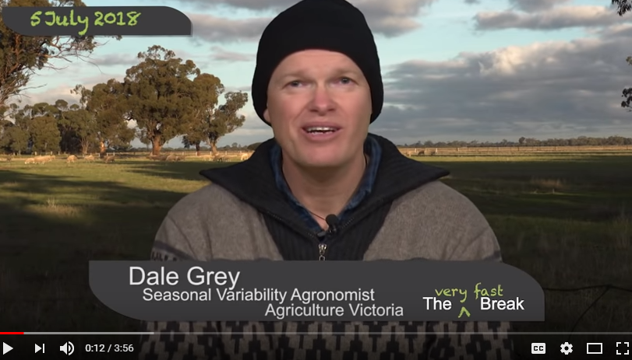
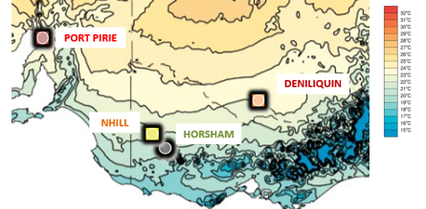
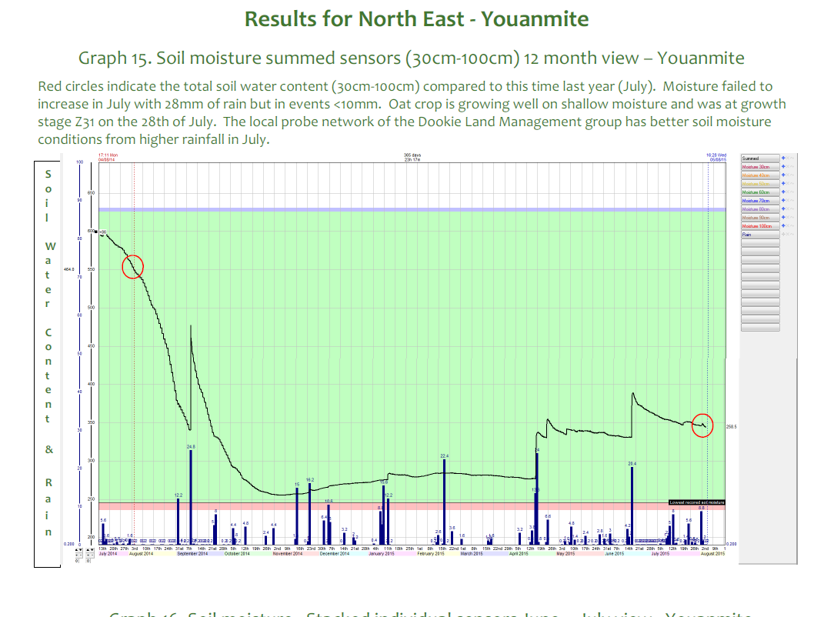
Agriculture Victoria
Seasonal Risk Team
Climate literacy, seasonal variability & change, extension products for Victoria
Monthly “commentary” The Break youtube
Global forecast comparisons for Vic
Deep soil moisture probe data & technology
Package up climate/carbon R&D
120 forums/year – upscaling climate drivers & variability via request
ClimateDogs, analogues, capability for advisory sector
(me, Dale Grey, Dale Boyd, Liz Hamilton)

Slide 3
The three “P”’s of climate change impacts:
Physical – effects of what the climate does (heat waves, droughts, floods, wild weather etc)
Policy – the impacts of changes to policy (reform around issues such as water, carbon trading, energy, renewables, bushfires, planning, coasts, drought support, transport, rural health etc)
People – how others respond (consumers, banks, insurance, trade/market/supply chains etc)

Slide 4
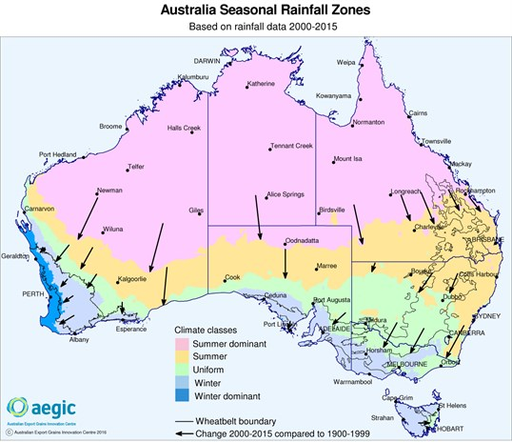
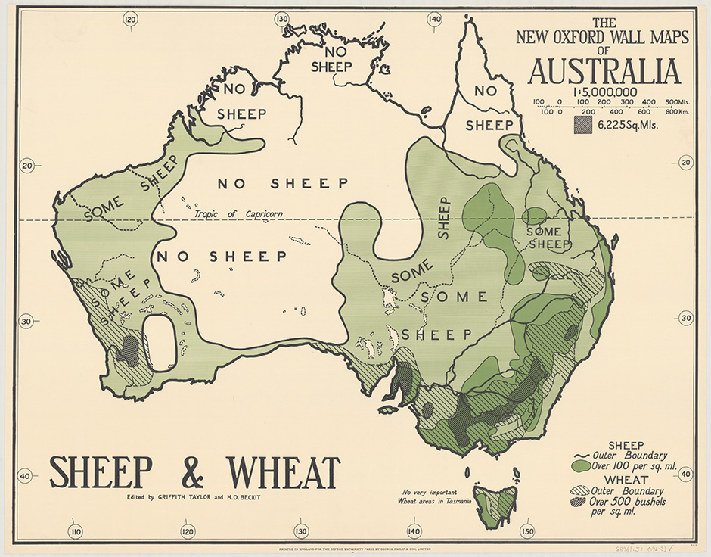
Farmers adapting to lots of things…..
Land use 1920’s
www.aegic.org.au/media/news/2016/02/new-australian-climate-developing.aspx

Slide 5
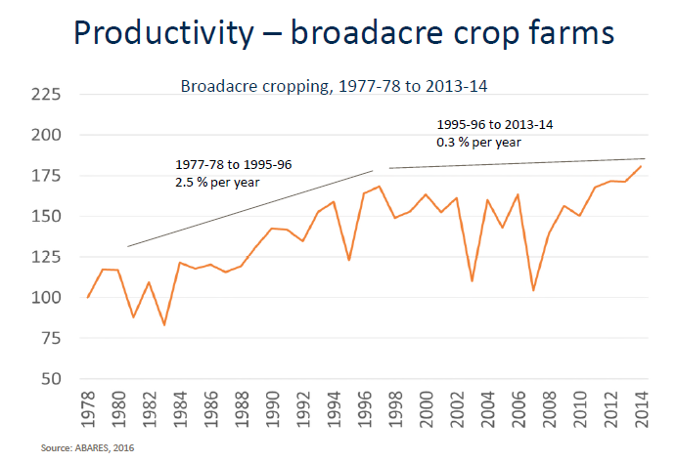
Climate change & variability – a tag team
Climate change will appear one week, season & year at a time – under the cloak of “variability”
Context for decisions - short, medium or longer term timeframes? (frame for decision making today)
Non-stationary climate system = whole new set of challenges (it’ll keep on changing folks…...)
Climate Models vs What actually happens (eg already at 2030 (days>35), blocking & extreme weather events)
Removing a ‘slice’ from our ag productivity efforts

Slide 6
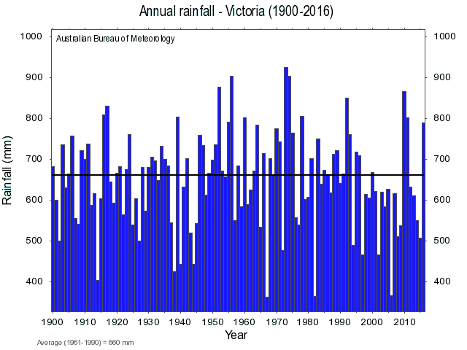
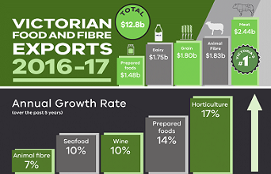
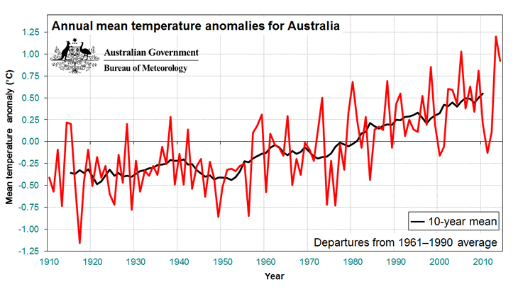
Farmers & Agriculture ingredients for success:
Modern technologies, R&D, genetics, innovations etc
Improved farm & regional infrastructure (eg storage, water, fodder, communications, transport, social etc)
Growth in local & export markets (and biosecurity)
Business management for variable years & income
Farm plans, min-tillage, soils, pasture cover, NRM skills
Networks, knowledge channels, confidence to grow

Slide 7
Different audiences….different needs?
Successful & going places….
Some hanging on until ……
Others that could go either way….

Slide 8
Various levels or
“LENS” for adaptation?
Individual/farm/business
Local community, Regional, National?
Industry-supply chain
Conflicting aims can occur……

Slide 9
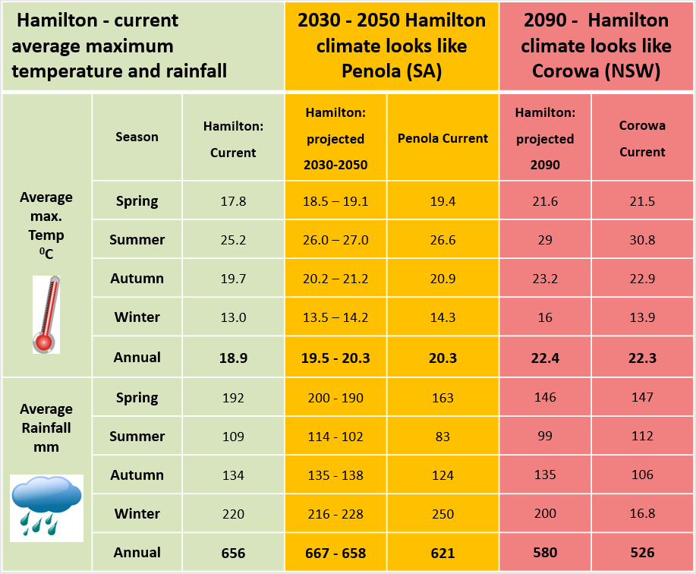
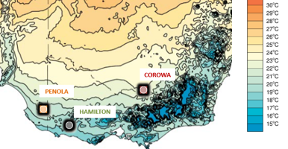
Planning for the future
Eg What might Hamilton’s climate be like in 2030-50 & 2090?
Climate Analogues explore what the future climate could be like for a given location. These analogue localities have been developed using the Analogues Explorer Tool from the CSIRO’s Climate Change in Australia. This tool matches the proposed future climate of a region with the current climate experienced in another region using average annual rainfall and mean annual max. temperature (within set tolerances). They were developed using the maximum consensus of models (based on CMIP5) for the high greenhouse gas emissions scenario, (RCP 8.5). These analogues have been further refined to align with projected seasonal changes based on Model GFDL-CM3. from 2030-2050 and Model GFDL-CM3 for 2090 based on advice from CSIRO. This assumes a slight rainfall increase to 2030, later declining across the Southern Slopes Region and an average temperature increase of 3.5C⁰ by 2090, based on data from the Climate Futures Tool.
Include climate in discussions on future
Variety of issues/ timelines (water,pasture,infrastructure)
eg Analogue climate tool
Mean annual
Max.
temp C⁰
More info: Liz Hamilton – Agriculture Victoria

Slide 10
Adoption & Practice change - rule of thumb!
We all change practice/behaviour when :
IT WORKS! (Proven Technology or Practice) The technology/practice is known & proven to work, not a risky experiment (R,D technology & innovation flow)
I WANT TO! (Attitude) It makes sense to change for some benefit I value (much better than current state)
I CAN! (Capacity) I have capacity to do it - eg time, labour, finances, skills, service providers to make it happen & maintain it (there’s nothing holding me back)
“Getting 2 out of 3 of these isn’t enough!”

Slide 11
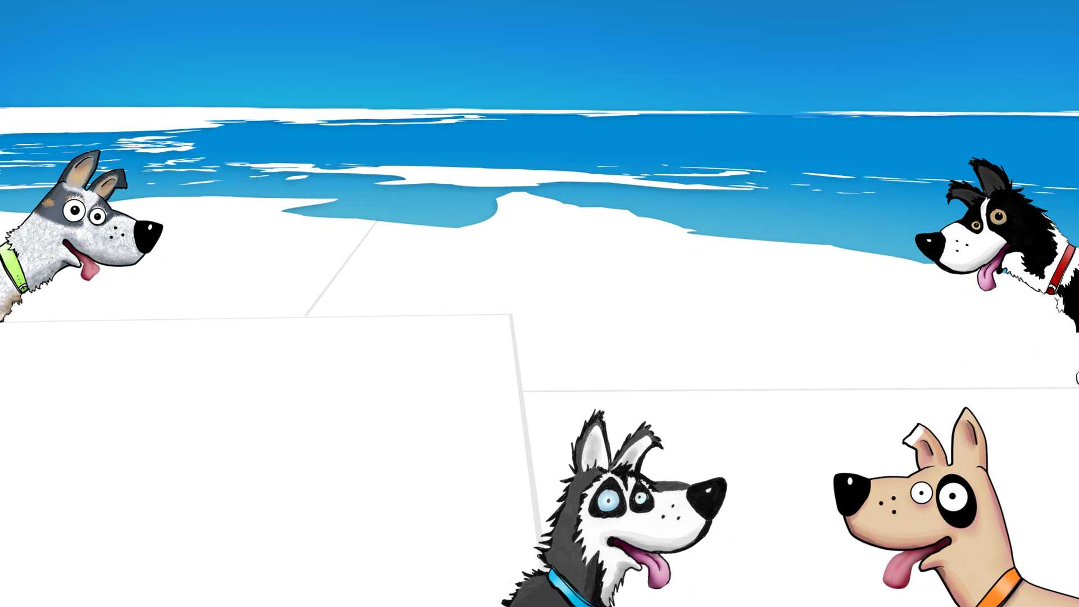
Thank You
Subscribe to ‘The Break’
The.Break@ecodev.vic.gov.au
Checkout the new National ClimateDog animations!!!!
www.climatekelpie.com.au/understand-climate/climatedogs
graeme.anderson@ecodev.vic.gov.au
Tweets @climatedogs

