Slide 2
Dianne
“Solar is a great idea…”

Slide 3
“But I don’t…”
have spare cash
know which system to get
know who to trust

Slide 4
Removing
Barriers
Financial
Information
Trust

Slide 5
Removing Barriers
Financial
Low interest (4.75%) bank loan
Council rates loan (0%)
Notes:
Loan attached to property – peace of mind for Dianne that if she left the property the loan wouldn’t follow and peace of mind for the council that they could recover the full amount of the loan

Slide 6
Removing Barriers
Financial
Low interest (4.75%) bank loan
Council rates loan (0%)
- 10% GST saving
- Loan attached to property
Notes:
Loan attached to property – peace of mind for Dianne that if she left the property the loan wouldn’t follow and peace of mind for the council that they could recover the full amount of the loan

Slide 7
Removing Barriers
Information
“Understandable, easy to read, without any jargon”
“Handed to me on a platter”
Informed decision

Slide 8
Removing Barriers
Trust
“Council research on which solar system to get”

Slide 9
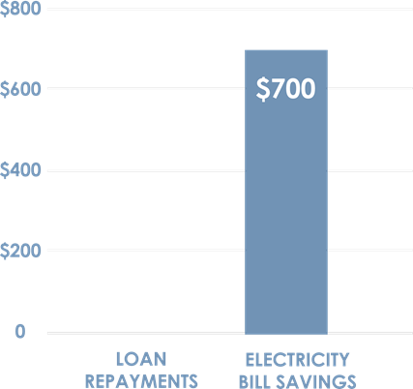
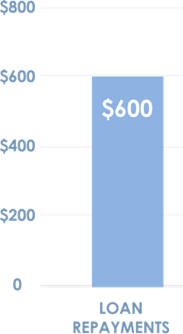
Removing Barriers
Trust
Honest assessment of Solar ($100/year net benefit)

Slide 10
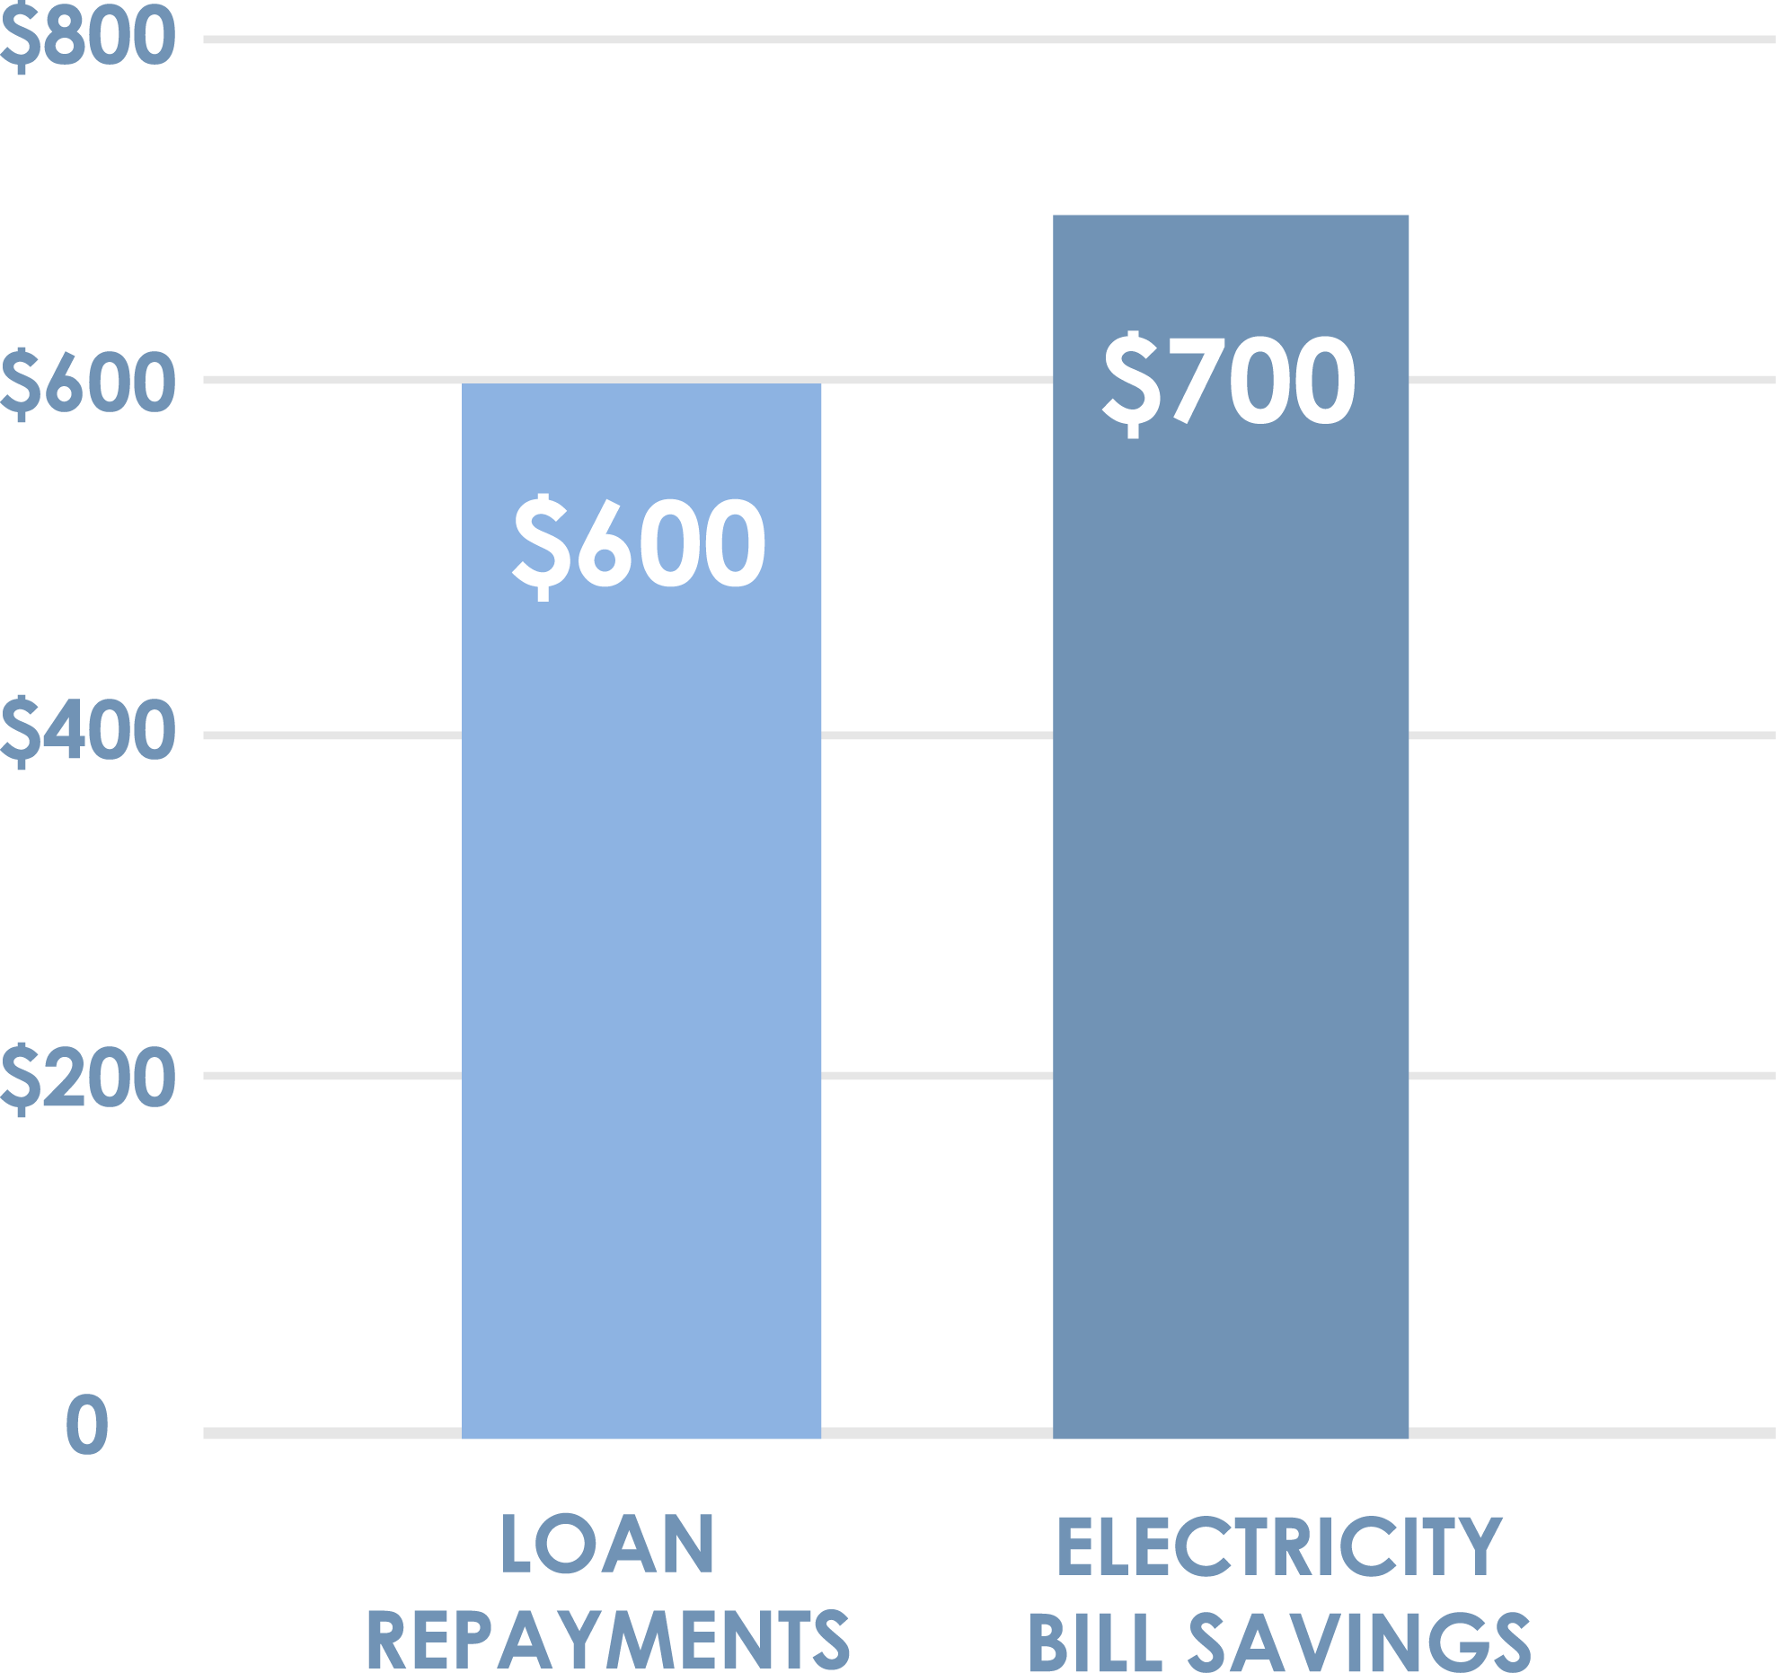
Removing Barriers
$100
Trust
Honest assessment of Solar

Slide 11
Removing Barriers
Trust
Honest assessment of Solar

Slide 12
Removing Barriers
Trust and information significant barriers

Slide 13
Dianne today
47% decrease in electricity use from Feb. – April 2018

Slide 14
Dianne’s advice…
“Do it”
Notes:
Yet again LOCAL GOVERNMENT gets its act together whilst the other levels of Government simply dither and do nothing

